Slide 1

Memento Design Pattern

Slide 2
Memento Design Pattern
Memento pattern falls under behavioral pattern category. Memento pattern is used to restore state of an object to a previous state.
Memento pattern uses three actor classes: Memento, Originator and CareTaker

Slide 3
Actor Classes
Memento - The basic object that is stored in different states.
Originator – Sets and Gets the values from the currently targeted Memento. Creates new Mementos and assigns current values to them.
CareTaker – Holds a list that contains all the previous versions of Memento. It can store and retrieve the strored Mementos.

Slide 4
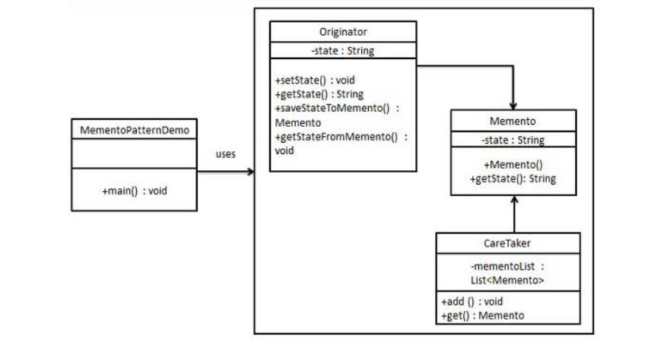
Example

Slide 5
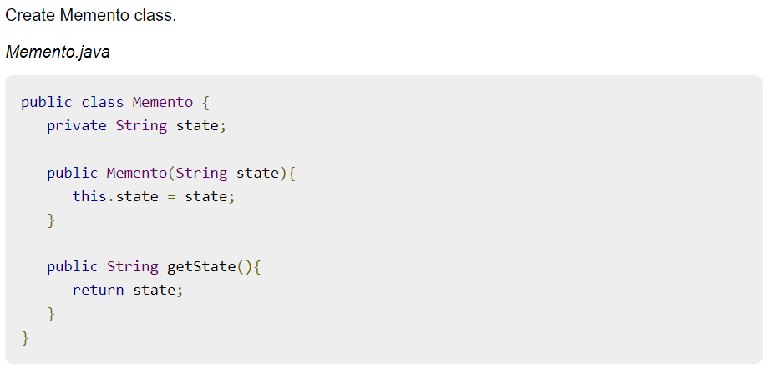

Slide 6
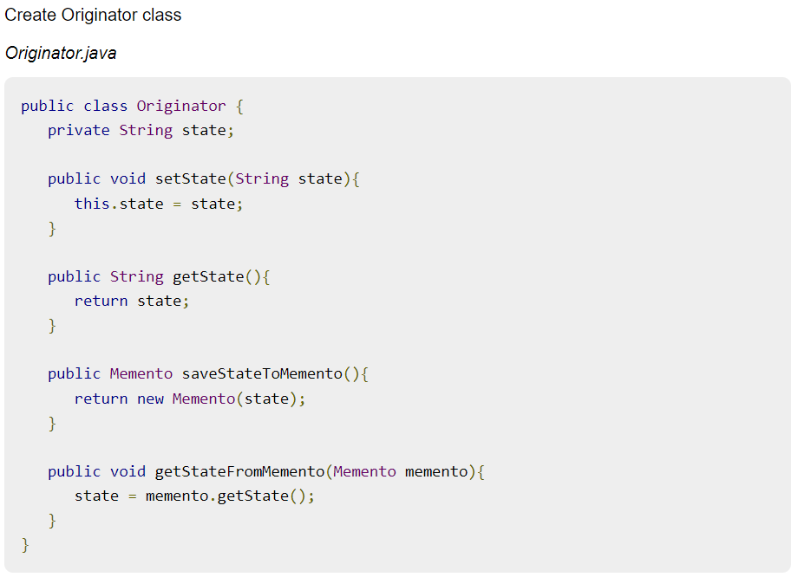

Slide 7
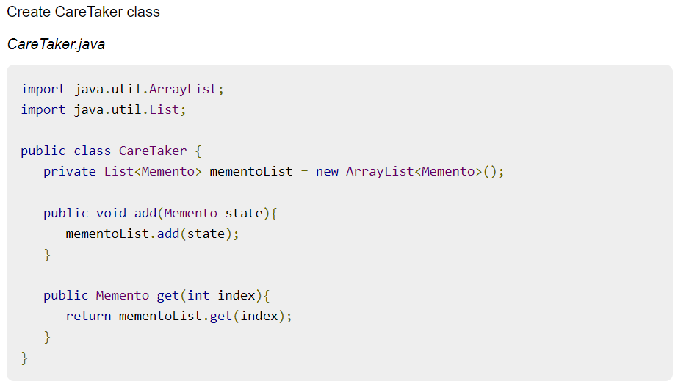

Slide 8
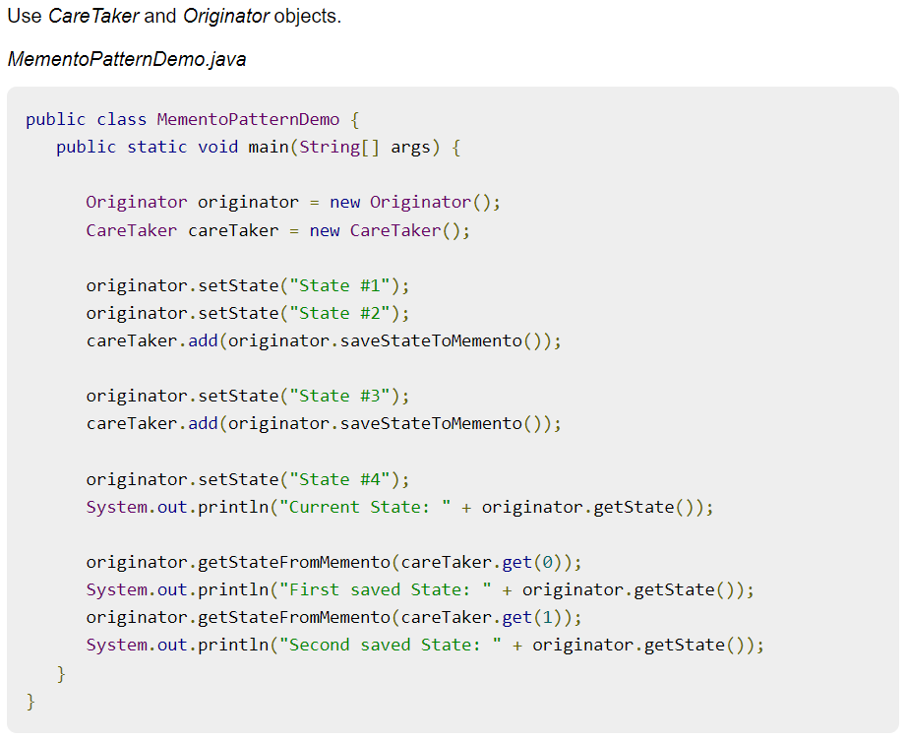

Slide 9
